Slide 1

ORDERING OF FOOD IN STALLS BY CUSTOMERS
PRESENTED BY
SOWMIYA S

Slide 2
AGENDA
MULTITHREADING
PARALLELISM
THREADS
CREATION AND RUNNING OF THREADS
ORDERING OF FOOD IN STALLS BY CUSTOMERS (Project Explanation)
ADVANTAGES AND DISADVANTAGES OF THE PROJECT
CODE SNIPPET OF THE PROJECT
OUTPUT OF THE PROJECT

Slide 3
MULTITHREADING
Multithreading is a programming concept in which the application can create a small unit of tasks to execute in parallel or concurrent.
It is the ability to execute multiple threads independently at the same time but share the process resources simultaneously.
It will make the execution of the program fast and easy.
Java has great support for multithreaded applications. Java supports multithreading through Thread class.

Slide 4
PARALLELISM
Parallelism is the ability to execute independent tasks of a program in the same instant of time.
Each thread can run on a separate process at the same time, using a number of resources resulting in parallel execution.
This is only applicable when we have more than one thread.

Slide 5
THREADS
Threads in Java is a lightweight process that allows multiple tasks to be executed simultaneously within a single program.
We can create multiple threads in single process and each thread is independent of the other.
Threads used to achieve parallelism and improve performance and responsiveness.
It has two types:
User Threads – High priority threads. The JVM will wait for any user thread to complete its task before terminating it.
Daemon Threads – Low priority threads, whose only role is to provide services to user threads.

Slide 6
CREATION AND RUNNING OF THREADS
Two ways to create a Thread:
Extending the Thread Class.
Implementing Runnable Interface in Java.
Two ways to run a Thread:
If the class extends the Thread class, the thread can be run by creating an instance of the class and call its start() method.
If the class implements the Runnable interface, the thread can be run by passing an instance of the class to a Thread object's constructor and then calling the thread's start() method.

Slide 7
ORDERING OF FOOD IN STALLS BY CUSTOMERS (Program Explanation)
This project is about the Food Stall where the Customers can place orders in Parallel can be done using Parallelism Multithreading in Java.
This project demonstrates Parallel Processing of Customer orders in Food Stall using Java Executor Framework.
JAVA EXECUTOR FRAMEWORK
Java provides its own multi-threading framework called the Java Executor Framework.
The Executor Framework is a powerful and flexible tool for managing and executing tasks in Java applications.

Slide 8
ADVANTAGES OF THE PROJECT
Improved Efficiency
Enhanced Scalability
Reduced Bottlenecks
Realtime Updates
Load Balancing

Slide 9
DISADVANTAGES OF THE PROJECT
Complex Implementation
Synchronization Challenges
Increased Resource Consumption
Debugging Complexity
Compatibility and Portability

Slide 10
CODE SNIPPET OF THE PROJECT
import java.util.concurrent.ExecutorService;
import java.util.concurrent.Executors;
class FoodStall
{ public void takeOrder(String custName, String foodItem)
{ System.out.println(custName + " is ordering " + foodItem); System.out.println();
try // Simulate food preparation
{ Thread.sleep(3000); } catch(Exception e)
{ e.printStackTrace(); }

Slide 11
System.out.println(foodItem + " is ready for "+custName);
System.out.println(); }}
class custOrder implements Runnable
{ private String custName, foodItem;
private FoodStall foodStall;
public custOrder(String custName, String foodItem, FoodStall foodStall)
{ this.custName = custName;
this.foodItem = foodItem;
this.foodStall = foodStall; }

Slide 12
@Override
public void run()
{ foodStall.takeOrder(custName, foodItem); }
public static void main(String[] args)
{ FoodStall fs = new FoodStall();
ExecutorService executor = Executors.newFixedThreadPool(5);
String[] customers = {"customer 1", "customer 2", "customer 3", "customer 4", "customer 5"};
String[] orders = {"Burger", "Pasta", "Noodles", "Briyani", "Fried Rice"};

Slide 13
for(int i=0; i<5; i++)
{
Runnable order = new custOrder(customers[i], orders[i], fs);
executor.execute(order);
}
executor.shutdown();
}
}

Slide 14
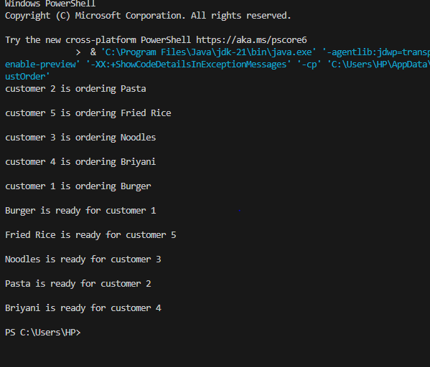
OUTPUT OF THE PROJECT

Slide 15

THANK YOU

